Slide 1

Prospective, observational, multicenter, non-randomized study on Ischemia with Non-Obstructive Coronary Artery disease
in Italy: the INOCA-IT
Registry (RF-2019-12369486)
Antonio Maria Leone
on behalf of INOCA IT investigators*
Center of Excellence in Cardiovascular Sciences
Ospedale Isola Tiberina Gemelli Isola
Università Cattolica del Sacro Cuore
Roma
*Milan: A. Chieffo (PI), G. Ghizzoni; Rome: A.M. Leone, D. Galante; Naples: G. Esposito, L. Di Serafino

Slide 2
Potential conflicts of interest
Speaker's name: Antonio Maria Leone
☑ I have the following potential conflicts of interest to report:
Dr. A.M. Leone is consultant for Abbott, Menarini and Bracco/Acist and received speaking honoraria from Abbott, Medtronic, Bayer, Menarini, Bruno and Daichii Sankyo.

Slide 3
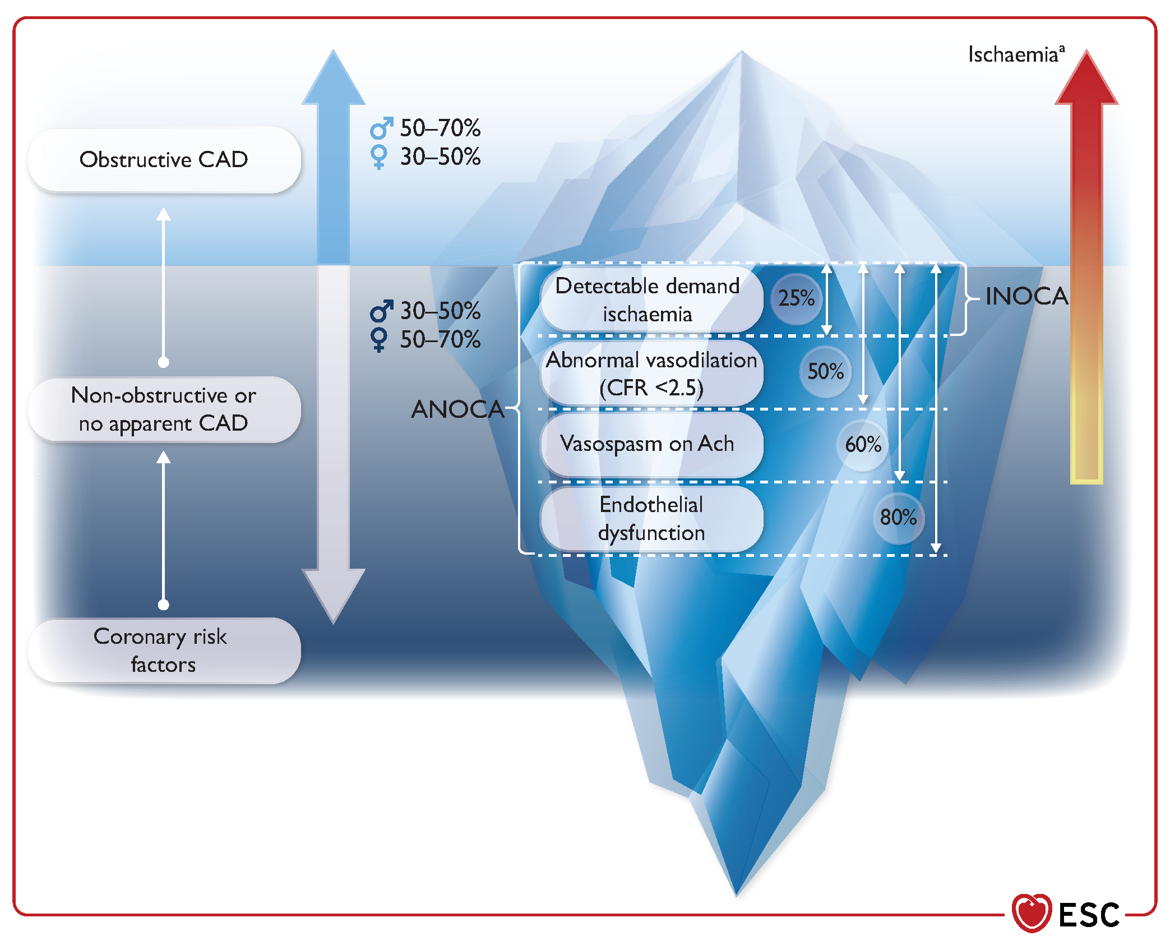
INOCA
Estimated 3–4 million cases/year (ACC NCDR)
Symptoms: typical or atypical angina - nausea, fatigue, palpitations (?)
Not a benign condition - ↑ Risk of MACE (WISE trial)
- ↓ quality of life

Slide 4




Study Design
Study type: Observational, prospective, multicenter, non-randomized study
Partecipating centers:
IRCCS San Raffaele Scientific Institute, Milan, the promoter Center;
Institute of Cardiology, Fondazione Policlinico Universitario A. Gemelli IRCCS, Università Cattolica del Sacro Cuore, Rome;
Interventional Cardiology Unit, Azienda Ospedaliera Universitaria Federico II, Naples.
80
77
56
🟢 Total patients enrolled: 213
Notes:
The INOCA-IT Registry is an observational, prospective, multicenter, non-randomized study conducted at three Italian centers.
The San Raffaele Hospital in Milan, the sponsoring center, enrolled 80 patients; the Policlinico Gemelli in Rome enrolled 77; and the Federico II University Hospital in Naples included 56 patients.
A total of 213 patients were enrolled.

Slide 5
Study Objectives
1
PREVALENCE
To compare INOCA prevalence in women vs men in 3 Italian centers (North, Center, South)
ENDOTYPE STRATIFICATION
To identify INOCA endotypes based on invasive coronary functional testing
TAILORED THERAPY
To evaluate impact on angina severity, QoL, and MACE at 12 months
2
3
Notes:
The INOCA-IT study was born with three fundamental objectives.
The first is to evaluate the prevalence of different forms of INOCA among women and men, and among patients enrolled in the three Italian centers involved.
The second objective is to correctly stratify patients into their respective functional endotypes, in order to direct them towards the most appropriate therapy, based on the mechanism responsible for the ischemia.
The third objective is to evaluate whether this personalized approach actually leads to clinical improvement, at 12-month follow-up, in terms of symptoms, quality of life, and cardiovascular outcomes.
These are, therefore, the three key points on which the project focused and which guided us in the analysis of thedati.

Slide 6

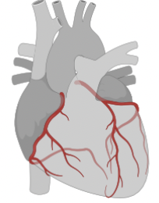




Timeline
INOCA-IT Registry initiation
FFR/RFR
CFR/IMR
Ach test
Tailored therapy administered based on endotype, according to ESC/EAPCI consensus document*
Dec 2021
Enrollment
Invasive Coronary Functional Testing
Therapy*
12-month follow-up
Diagnosis*
Chronic angina due to IHD with indication for coronary angiography
Absence of obstructive CAD
Age >18 years
Valid written informed consent
SAQ Score
EQ-5D-5L
MACE
CMD
VSA
Microvascular spasm
NCCP
*Kunadian and Chieffo et al. Eurointervention 2021
Notes:
This slide shows the timeline of the INOCA-IT study.
The study began in December 2021 with the enrollment phase, meeting the inclusion criteria: symptomatic chronic ischemic heart disease with indication for coronary angiography, absence of significant obstructive coronary artery disease, age over 18, and written informed consent.
After enrollment, all patients underwent invasive coronary functional tests: FFR, iFR, CFR, IMR, and acetylcholine test, with the aim of evaluating coronary physiology and determining the mechanism of ischemia.
Based on the results obtained, a functional diagnosis was formulated, and patients were classified into four diagnostic groups: CMD (Coronary Microvascular Dysfunction), VSA (Vasospastic Angina), Microvascular Spasm, or NCCP (Non-Cardiac Chest Pain).
Each patient was then prescribed a personalized therapy, in line with ESC/EAPCI recommendations, based on the identified endotype.
Follow-up was conducted 12 months after enrollment, via telephone contact or outpatient visit, to assess angina class, general health status, and the occurrence of cardiovascular events.
Anginal symptoms and quality of life were measured using two validated instruments: the Seattle Angina Questionnaire (SAQ) and the EQ-5D-5L.
The SAQ analyzes five domains: physical limitation, angina stability, frequency of episodes, satisfaction with treatment, and quality of life, with scores from 0 to 100, where higher values ​​indicate better health.
The EQ-5D-5L assesses perceived health in five areas: mobility, personal care, daily activities, pain/discomfort, and anxiety/depression, providing a summary score.
Finally, any major cardiovascular events were recorded, particularly hospitalizations for cardiovascular causes and revascularizations for persistent angina.

Slide 7
Endotypes and treatment
Diagnosis
CFR < 2 e/o IMR > 25
Negative Ach test
CMD
Beta-blockers, CCBs, Ranolazine
CCBs, Nitrates
CCBs, Nitrates
No further cardiac tests
CFR ≥ 2 e/o IMR < 25
Ach test: angina, ECG shift,
epicardial spasm
VSA
ACh test: angina, ECG shift
No epicardial spasm
Microvascular
spasm
CFR ≥ 2 e IMR < 25
Negative Ach test
NCCP
Therapy
Notes:
This slide shows the classification of patients enrolled in the study, based on the results of invasive coronary function tests.
Patients with microvascular dysfunction, diagnosed with a CFR < 2.0 and/or IMR > 25, were treated primarily with beta-blockers (nebivolol or carvedilol), calcium channel blockers, and in some cases, ranolazine.
Epicardial vasospastic angina was diagnosed in the presence of vasospasm ≥ 90%, typical chest pain, and ECG changes during the acetylcholine test. Treatment included calcium channel blockers, even at high doses, short-acting nitrates, and, in severe cases, drug combinations.
In cases of microvascular spasm, with symptoms and ECG changes but without epicardial vasospasm, therapy was similar to VSA. Finally, patients with negative tests were classified as NCCP, and referred for non-cardiological evaluation, with anti-anginal therapy discontinued.

Slide 8
Study population
Demographic data
Median age: 61yrs (range: 36–82)
♀️ 128 Women: 60,1%
♂ 85 Men: 39,9%
Cardiovascular risk factors
Hypertension 63,8%
Dyslipidemia 70,4%
Diabetes mellitus 15,5%
BMI median 26.3 kg/m²
Smoking ♂ current 32,9% vs 15,6%
♀️ former 68,8% vs 44,7%
Notes:
This slide shows the general characteristics of the enrolled population.
The sample includes 213 patients, with a median age of 61 years. As expected for this condition, a female predominance is observed, with women representing 60.1% of the total.
Cardiovascular risk factors are well represented.
Statistically significant values ​​were found regarding smoking habits, particularly in the difference between active smokers, more frequent among men (32.9%), and former smokers, more frequent among women (68.8%).

Slide 9
Baseline differences across study centers
♀️/♂ Gender distribution: similar across centers
Median age higher in Central Italy (p = 0.007)
Hypertension more frequent in South (p < 0.001)
Dyslipidemia also higher in South (p = 0.035)
65 vs 59.5 yrs
83,9%
Notes:
This slide reports the main clinical and demographic characteristics of patients enrolled at the three centers, with the aim of highlighting any statistically significant differences between the different geographical areas involved: The gender distribution is similar across the three centers, with a consistent female predominance, consistent with the known characteristics of INOCA.
Regarding the average age, the Center is higher, at 65 years, compared to the North and South, where it stands at around 59.9 years.
A statistically significant finding concerns cardiovascular risk factors in the South, where 83.9% of patients have both dyslipidemia and arterial hypertension, a higher prevalence than in the other two centers.

Slide 10
Initial Angina Profile and Quality of Life
Clinical Presentation
SAQ Score
EQ-5D-5L
Typical chest pain: 87,3%
CCS grade II-III: 73,2%
EQ VAS score: 65♀️ vs 75♂
South
CCS II: 96,4%
NYHA II: 100%
Notes:
This slide illustrates data on the clinical presentation and perceived quality of life of enrolled patients.
Almost all presented with typical angina, predominantly in CCS class II or III. In particular, the prevalence of CCS class II was statistically significant in the central and southern regions, where 100% of patients were also in NYHA class II.
Regarding quality of life, data collected with the Seattle Angina Questionnaire (SAQ) show a significant gender disparity: women reported worse scores, particularly in the domains of physical limitation and angina stability.
This trend is also confirmed by the EQ-5D-5L questionnaire: the VAS score, which reflects global health perception, was significantly lower in women, with a median value of 65 versus 75 in men.
Analyzing the individual domains of the EQ-5D-5L, women more frequently report moderate or severe conditions: for example, 54.6% of women report difficulties with mobility, compared to 36.6% of men. In the personal care dimension, however, the most marked difference concerns anxiety and depression, with 43% of women reporting moderate to severe symptoms, compared to less than 19% of men.
These results, obtained from validated instruments, clearly indicate that women with INOCA report a significantly higher symptom burden and a lower quality of life, despite a similar initial clinical classification compared to men.

Slide 11
INOCA endotypes
CMD: Coronary Microvascular Dysfunction
VSA Vasospastic Angina
Microvascular Spasm
NCCP Non-Cardiac Chest Pain
CMD + VSA
CMD + Microvascular spasm

Slide 12
INOCA endotypes
CMD: Coronary Microvascular Dysfunction
VSA Vasospastic Angina
Microvascular Spasm
NCCP Non-Cardiac Chest Pain
CMD + VSA
CMD + Microvascular spasm
South 32,1% (p=0,05)

Slide 13
INOCA endotypes
CMD: Coronary Microvascular Dysfunction
VSA Vasospastic Angina
Microvascular Spasm
NCCP Non-Cardiac Chest Pain
CMD + VSA
CMD + Microvascular spasm
South 32,1% (p=0,05)
100% ♀️

Slide 14
Incidence of Adverse Events associated to ICFT
Adverse Event (AE) in 19 pts (8.9%)
Mild to moderate AE in 18 pts
Serious Adverse Events (SAE)
Atrial fibrillation | 3,8%
Sinus bradycardia | 1,4%
Third-degree atrioventricular block | 1,4%
Brief sinus arrest | 1,4%
Transient vagal response | 0,5%
Reflex sinus bradycardia with prolonged sinoatrial pause | 0,5%
1 patient
Left main dissection during coronary angiography requiring complex PCI (Milan)
✅ No lasting complications observed – all events fully resolved
Notes:
Nineteen adverse events, representing 8.9% of the total, were recorded during invasive coronary artery function testing.
All were classified as mild, short-lived, and self-resolving or successfully managed with medical therapy.
The most common event was atrial fibrillation, observed in eight patients.
Only one case was a serious adverse event (SAE): a left main heart dissection during coronary angiography, complicated by cardiac arrest. Despite the severity of the event, the patient had complete clinical resolution after intensive treatment.
Overall, these data confirm an acceptable safety profile of the procedure, with no permanent or long-term complications in the enrolled patients.

Slide 15
Clinical and functional changes over-time
CCS class
NYHA class
p=0.01
Notes:
At one year clinical follow-up, we observed a statistically significant improvement in CCS angina class (CCS I from 10.3% at baseline to 61.8% at follow-up, while CCS class III–IV decreased markedly from 35.6% to 4.9%, p<0,001), a notable increase in median SAQ summary score (from 57.5 at baseline to 81.8 at follow-up, p<0.001) and improvement of New York Heart Association functional class (NYHA class I rose from 47.9% to 68.6%, while NYHA class III decreased markedly from 6.6% to 2.4%, p<0,001).

Slide 16
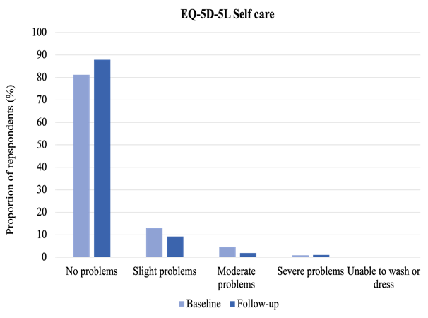
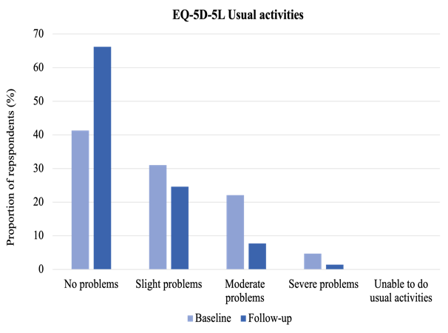
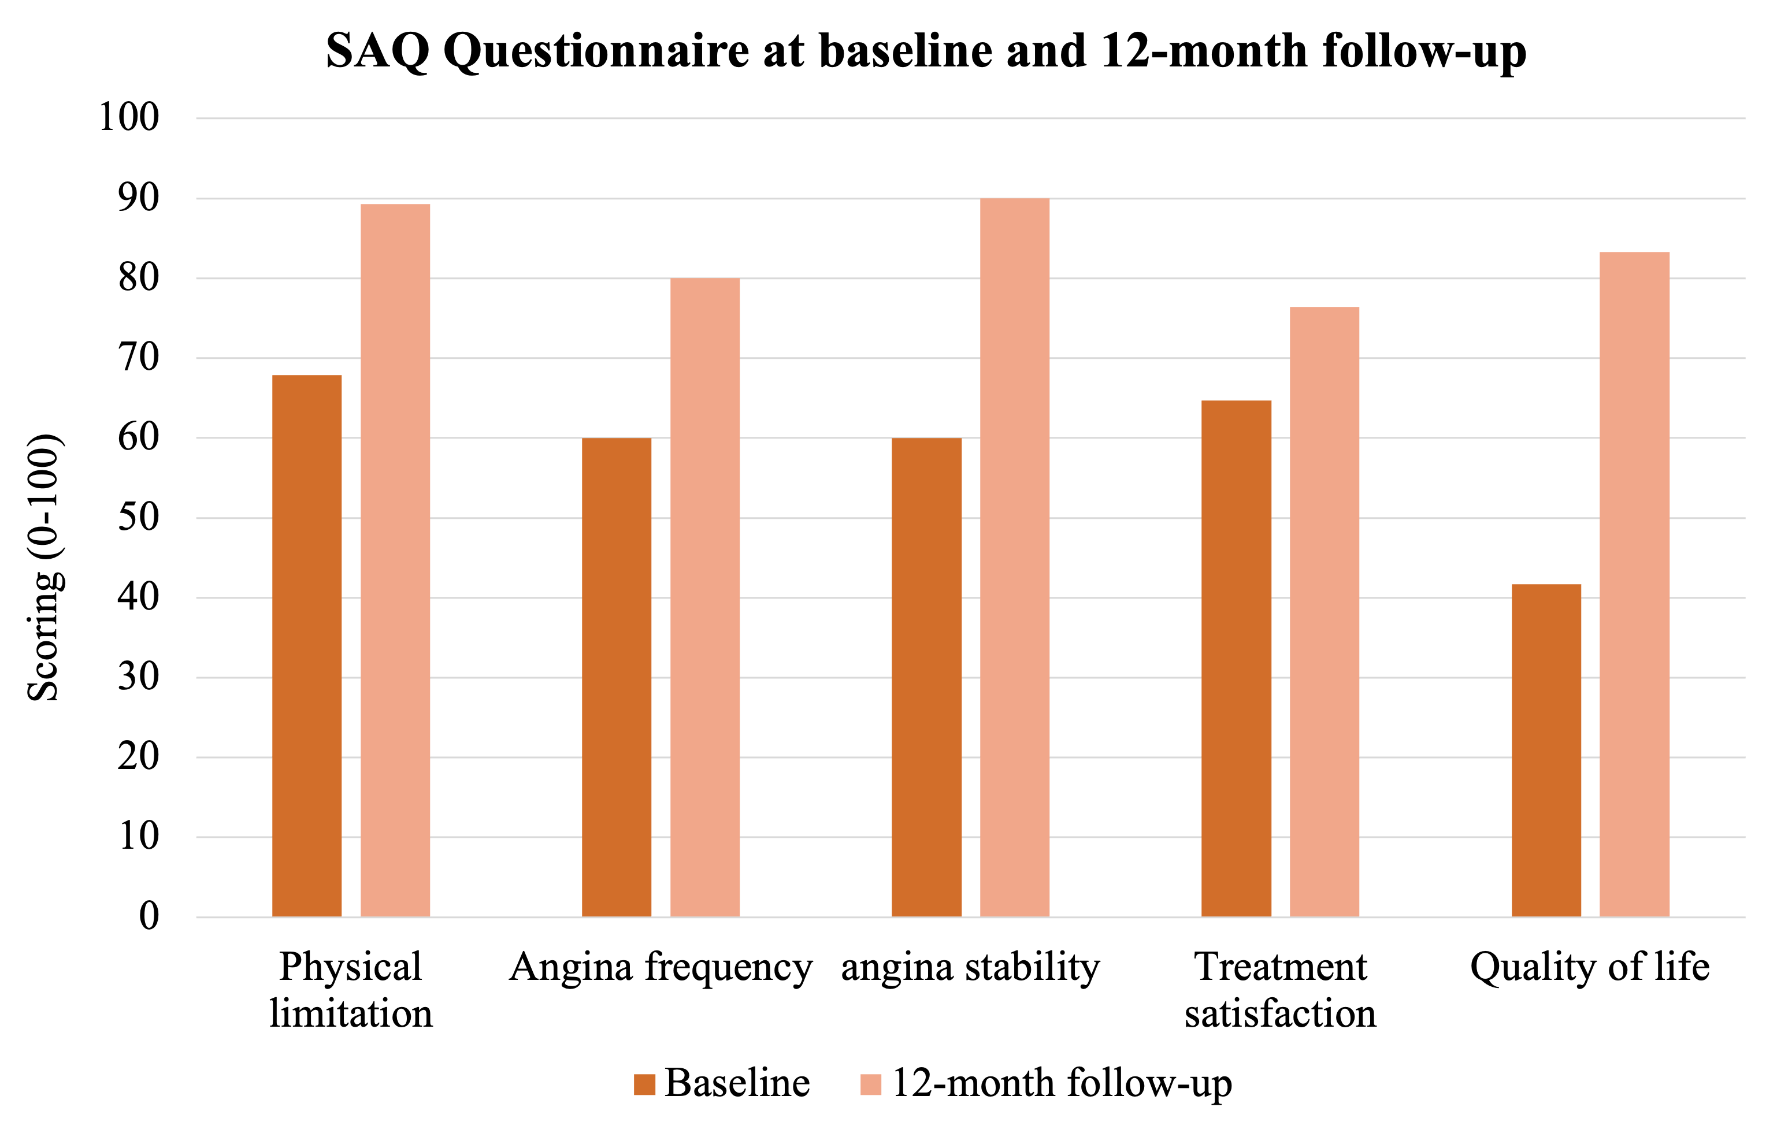
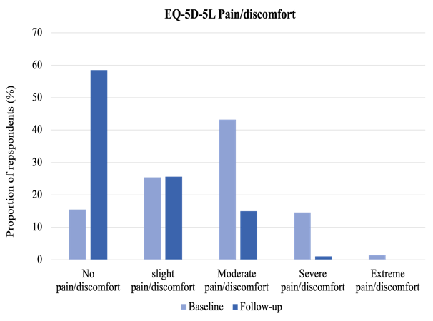
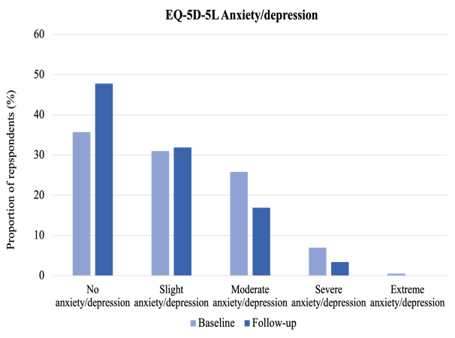
Clinical and functional changes over-time
SAQ Score
EQ-5D-5L
From 57.5 to 81.8
p<0.001
EQ-5D VAS From 70 to 80
Notes:
.
Similarly, each EQ-5D-5L domain improved significantly (i.e. mobility, self-care, usual activities, pain/discomfort, anxiety/depression),
Twelve months after the functional diagnosis and the establishment of personalized therapy, the collected data show significant clinical improvement and an increase in the percentage of patients without mobility problems, from 52.6% to 72.9%.

Slide 17
Sex-Based Differences
SAQ Score
EQ-5D-5L
p<0.05
EQ-5D VAS 80 vs 80
p<0.05
p<0.05
Notes:
Despite the clinical improvement observed in both sexes, women continue to experience a higher residual symptom burden than men.
Women reported significantly worse scores in the domain of physical limitation (87.5 versus 96.4), and lower values ​​also in other domains—such as frequency and stability of angina, quality of life, and satisfaction with treatment—although, in the latter, the differences were not statistically significant.
The EQ-5D-5L further reinforces this observation: only 65.9% of women reported no mobility problems, compared to 84% of men. Furthermore, 21.4% reported moderate or severe pain (versus 7.4% of men), and only 41.3% of women reported no anxiety or depression, compared to 58% of male patients.

Slide 18
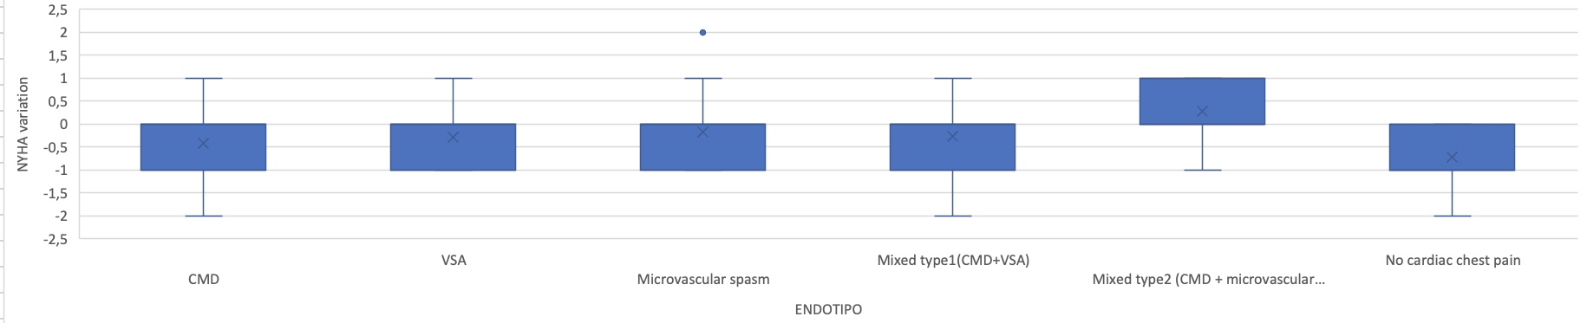
Endotype-Based Differences
NYHA CLASS
EQ-5D-5L
VSA had more functional limitations
- Mobility (p = 0.005)
- Self-care (p = 0.016)
NCCP more psychological distress
↑ moderate-to-severe (p = 0.014)
Usual activities (p = 0.003)
Pain/discomfort (p = 0.008)

Slide 19
MACE at follow up
7 total MACEs reported (out of 207 patients ≈ 3.4%)
Re-hospitalization for angina
Surgical unroofing of myocardial bridge
NSTEMI
Atrial Fibrillation
AVNRT
Femoral Pseudoaneurysm | Related to coronary procedure
Death
📌 Incidence of MACE was overall low and distributed across endotypes
Notes:
During the 12-month follow-up, a total of 7 major cardiovascular events (MACE) were reported, as summarized in the table.
The incidence of MACE was low overall and variably distributed among the different INOCA endotypes. However, no statistically significant differences emerged, mainly due to the limited sample size.

Slide 20
Conclusions
Prevalence of INOCA in Italy and its distribution in men and women across different regions globally confirms previous data
Different endotypes identified by ICFT are distributed quite homogenously while their overlapping is less frequent
Endotype-guided treatment is quite effective in improving symptoms and QoL
There’s still room for improvement by refining endotype classification and therapy

Slide 21
Thank you

